Slide 1
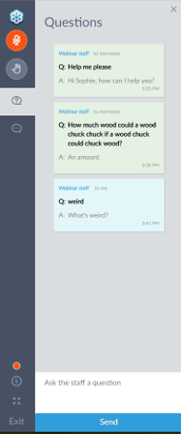
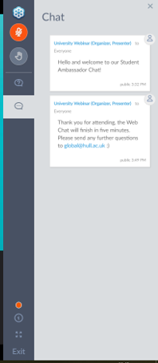
Questions – how to ask a question
There are two sections of the dashboard for you to use: ‘Chat’ and ‘Questions’.
In ‘Chat’ you will see messages from our panellists.
In ‘Questions’ you will be able to ask your questions and also see questions asked by other prospective students.
Type a question into the white box on the ‘Questions’ tab and press send.
Our panellists will then reply to you.

Slide 2
Why University
Notes:
NAME, I work as a JOB TITLE at the University of Roehampton.
Have you heard of us before? Brother, Sister or Cousin who went there?
It’s not far away. Beautiful campus, near to Putney, Hammersmith and Wembley. Supportive learning environment, Best Modern University in London.
My name is [insert name] and I am a current student at the University of Roehampton in my [1st/2nd/3rd etc) year studying [insert course]. I am here today to talk to you about what student life if really like and all the things I wish I had known before coming to university and what I have / had done at university.

Slide 3
AIM OF TALK
Why HE
What to expect
Making the most
of university.
Notes:
I am going to cover 3 things in this session.
What to expect
How to make the most out of university
The we are going to have a Q&A where you can ask me anything you want about university from how to know what accommodation to pick to what I would have done differently.

Slide 4
Why go to University?

Slide 5
Career
Notes:
Careers
On average a graduate will have a higher starting salary than a non-graduate. The new Graduate Labour Market Statistics show that, in 2017, English graduates and postgraduates had higher employment rates than non-graduates and the average, working age graduate earned £10,000 per year more than the average non-graduate
University gets you ready for a job by allowing you to develop an array of transferable skills that are hugely attractive to employers such as: research, presenting, critical thinking, communication, teamwork, organisation, and motivation. Not to mention the technical skills and knowledge you will gain at university.
Many employers are now just looking for their staff to have a degree and are not concerned about what subject they studied, giving you more flexibility.
Many universities now offer the opportunity to do a work placement or an internship as part of your degree programme. This is a wonderful opportunity to get relevant work experience whilst you are studying.
Women (£250,000)
Men (£170,000)

Slide 6
Higher Income
Notes:
http://www.bbc.co.uk/news/uk-politics-40965479
Graduates in a lifetime earn more than non-graduates by £250,000 for women and £170,000 for men.

Slide 7
= +£168,000
= +£252,000
(Walker & Zhu, 2013)
Notes:
https://assets.publishing.service.gov.uk/government/uploads/system/uploads/attachment_data/file/229498/bis-13-899-the-impact-of-university-degrees-on-the-lifecycle-of-earnings-further-analysis.pdf

Slide 8
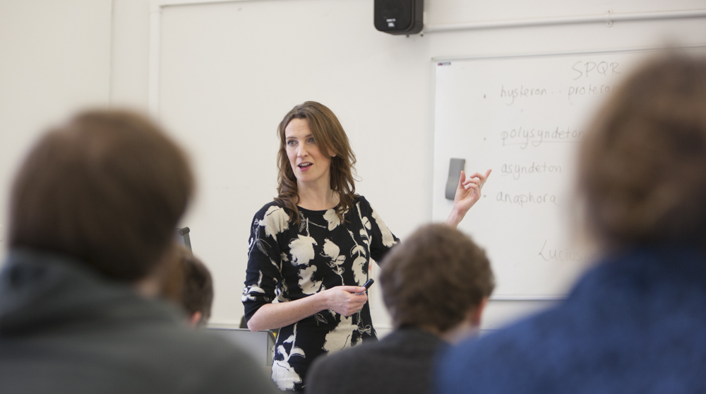
In-depth knowledge
Notes:
Specialised Career
Some jobs such as being a lawyer, doctor, nurse, vet etc. you MUST go to university and study in order to qualify.
Specialised Knowledge
- Grow your knowledge in a particular area and truly grasp the subject you are interested in.

Slide 9
Transferable skills
Notes:
While studying at university you will gain skills that future employers will be looking for. These will be gained through both your academic and social activities at university. Skills will include:
Research
Time Management
Organisation
Prioritising
Commitment
Multi-Tasking
Observation
IT skills
Problem Solving
Team Work
Creativity
Analysis
Evaluation
Essay Writing
Critical Thinking
Debating
Presenting
Speed-reading

Slide 10
Independence
Notes:
Independence
It also allows you to live away from home – it’s a stepping stone to the ‘real world’. This independence is one that my be hard to find with an apprenticeship or an entry level job as the rate of pay can be quite low, especially initially.
For many young people, going to university will be their first time living away from home. Although it might sound silly, going to university is a great opportunity to gain all those skills and experiences you will need as an adult including: managing a budget, buying all your own food and cooking meals for yourself, doing all your own clothes washing, travelling by yourself, cleaning and tidying etc.
However, it is worth mentioning that you do not have to move away from home when you got to university. Many people choose to live at home whilst studying, and still have a great experience.
Many universities offer opportunities to study abroad for a year or for a semester, not only is this a fantastic experience where you will meet new people, but it will also be a huge boost to your independence and looks great on a CV.

Slide 11
Social Life / new experiences
Notes:
Students union
Societies clubs
Living on campus
Study abroad
New people
New clubs

Slide 12
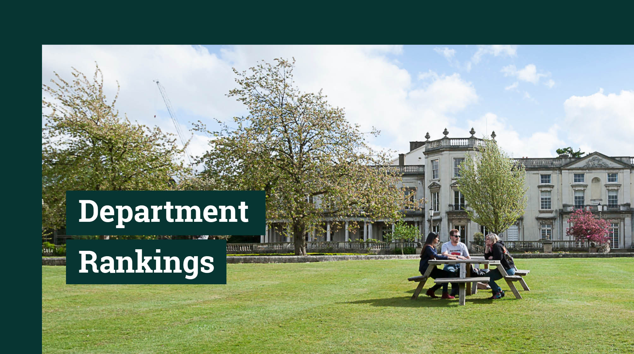
STUDENT
LIFE

Slide 13
TRUE
FALSE
○
True or False?
✗
Notes:
True or False.
If you think its true make a make a circle over your head. If you think the stamen is false make a cross.

Slide 14
TRUE
FALSE
Being a student is only about studying.
✓
Notes:
Being a student is only about studying. – FALSE
Being a student is so much more than just your studies. While studying is an important aspect of your student life its not all of it. You get to meet new people, try new things, have new experiences.
Moving out
Student Union – clubs, societies
Study Abroad
Extra Opportunities.

Slide 15
TRUE
FALSE
✓
You get a personal tutor at university.
Notes:
You get a personal tutor at university. - TRUE
Each university will run this a bit different but at the University of Roehampton every single students get their own dedicated personal tutor with dedicated office hour for their tutees, to talk to about any problems they might be having with their studies. There are also other support services.
We have a Welfare Officer in the Students’ Union who are able to help students with any issues they might be having. As well as being their social guides, the flat reps are also there to help students deal with any problems they might be having in relation to moving away from home or managing their workload.
Other services include the help for students with disabilities including dyslexia.
Roehampton offers a range of support services on campus. The first and most important of these is 24 hour security guards, all of whom are first trained, so there is always help on hand should anyone need it. We also have a doctors office and counselling service available to every student on campus should they need it. We have the accommodation office who are able to give you help with finding accommodation on and off campus, and a Money Doctors service to give you advice on how best to manage your money.

Slide 16
TRUE
FALSE
You can’t have a part time job at University.
✓
Notes:
You can’t have a part time job at university? – FALSE
As a student you will have a lot more spare time compared with what you are used to now. You can organise this anyway you like and many students have a part time job to get extra money while at university.
At Roehampton we have a job shop and careers centre on campus that students can use to find both a part-time job and as help in finding and applying for jobs after graduation. The centre offers sessions in helping students find jobs and gives advice on their applications. They can also receive email alerts from the job shop when new jobs of interest become available. The best thing about this service is that is always available to the students – even after they have graduated from the university. There are also opportunities to find work on campus in the bars, cafes, or even as a Student Ambassador to represent the university at events such as Open Days or UCAS Fairs.
You also have the opportunity to become a Student Ambassador, like me! This allows you to work flexibly around your studies, earn some extra money and tell other students how great the university is.

Slide 17
TRUE
FALSE
You have to live in university accommodation in your first year.
✓
Notes:
You have to live in university accommodation in your first year. - FALSE
You can live where ever you like. If you live at home and travel in or you can move into university accommodation.
There are lots of different types of accommodation available on our campus, but all of it is self-catered, meaning you will have to learn to cook for yourself at some point!
At Roehampton we have four different colleges here on campus.
Whitelands (Badgers)
Southlands (Sharks)
Digby (Lions)
Froebel (Zeebras)
Each of the colleges has its own accommodation. You have the option to share all facilities, or get an en-suite bedroom with your own bathroom facilities. Regardless of the type of room you choose to go for you will definitely be sharing the kitchen and social areas with the other students in your flat.
You could spend time living abroad. Spending a term overseas at a different university is a fantastic way to broaden your Horizons, meet new people, gain new cultural perspectives, gain a new sense of independence, gain skills and a breadth of experience employers will be attracted to AND have a fantastic time!
The University of Roehampton has exchange agreements with universities in Europe, Australia, the US and Latin America, giving you plenty of opportunities to study abroad for a term. We have a dedicated Study Abroad Team who are there to support you every step of the way.

Slide 18
TRUE
FALSE
✓
You become more independent at university.
Notes:
You become more independent at university. - TRUE
For most it will be the first time you move out, first time you have to cook for yourself, do your own washing and pay bills. Its not just in your personal life its in your studies as well.
Chose what your studying – some courses will let you pick your own modules
Chose when you are studying – you often get to pick your seminar times
Less contact time – more independent study
Your academic work at university involves a lot of independent research and self motivation. We recommend that you spend 200 hours of study on each module, including the time you spend in your lectures or seminars, etc. Don’t be fooled into thinking that university is all about partying, you will need to put the work in to ensure you get the grades needed to stay on your course.

Slide 19
WHAT TO EXPECT &
MAKING THE MOST

Slide 20
STUDENT LIFE
Notes:
Brainstorm – what does that mean?

Slide 21
Academic Studies
Notes:
There are 3 different styles your contact time with lecturers will take while at university. They are:
Lectures
Large groups of students listening to a lecture that lasts between 1 and 3 hours. This is where you will have to use your note taking skills as the lecturer will give you information that will be relevant for your essays and exams.
Seminars
Smaller groups of students discussing the topic that was covered in the lecture. This is a good opportunity to voice your own opinions and discuss the merits of various scholars on the subjects.
Tutorials
1-on-1 time with your lecturer to discuss your essay plans or any questions you might have about the topic or exams.
Your work at university will be assessed in a number of different ways, including:
Essays
Exams
Presentations
Debates
Blogs
Reflective journals
Webpages
Your academic work at university involves a lot of independent research and self motivation. We recommend that you spend 200 hours of study on each module, including the time you spend in your lectures or seminars, etc. Don’t be fooled into thinking that university is all about partying, you will need to put the work in to ensure you get the grades needed to stay on your course.

Slide 22
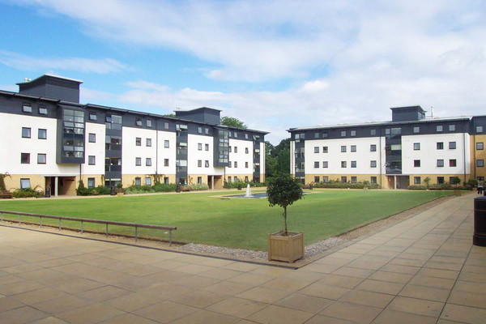
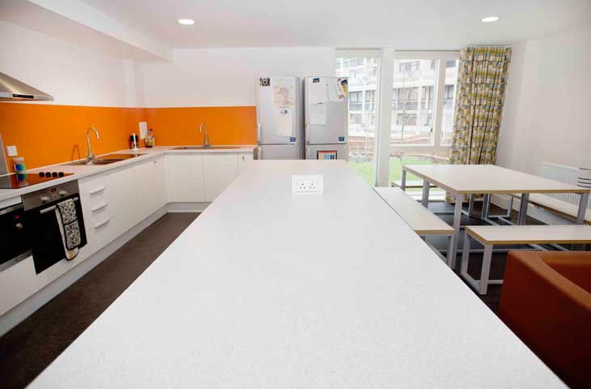
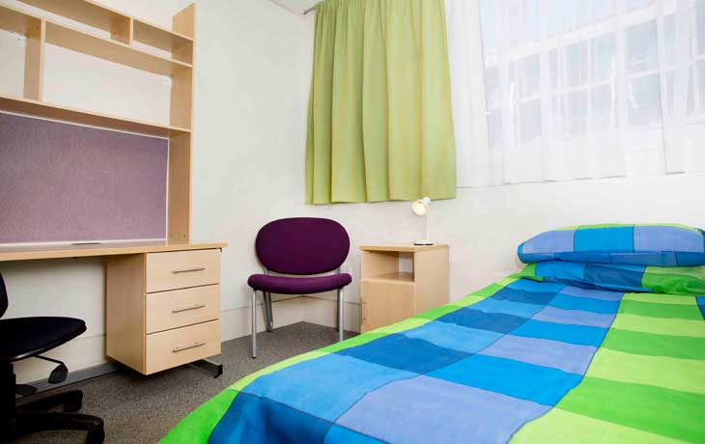
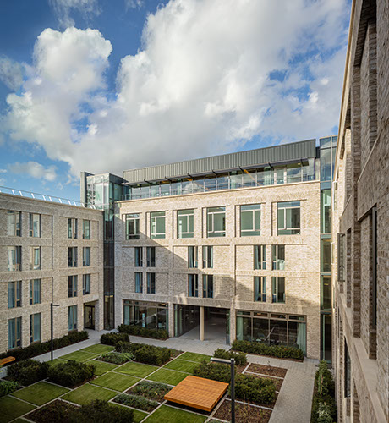
Accommodation
Notes:
https://www.youtube.com/watch?v=NYuy4_gC4SQ
Video about some of our accommodation options on campus.
There are lots of different types of accommodation available on our campus, but all of it is self-catered, meaning you will have to learn to cook for yourself at some point!
Each of the colleges has its own accommodation. You have the option to share all facilities, or get an en-suite bedroom with your own bathroom facilities. Regardless of the type of room you choose to go for you will definitely be sharing the kitchen and social areas with the other students in your flat.
The accommodation comes equipped with all the basic things you need at university, but it’s up to you to bring bedding, towels, toiletries, cooking utensils, crockery, cleaning products and anything else you may want to make your room feel more like home.
Accommodation prices varied for first years starting this year (September 2020) from £127.75 - £187.95. The price depends on which block you apply for and what type of room you have. The halls that have been more recently built will typically be the more expensive. You will also pay more if you want: a semi-ensuite or full ensuite room.
When you apply for accommodation you can make your decision based on your preferences and budget.

Slide 23
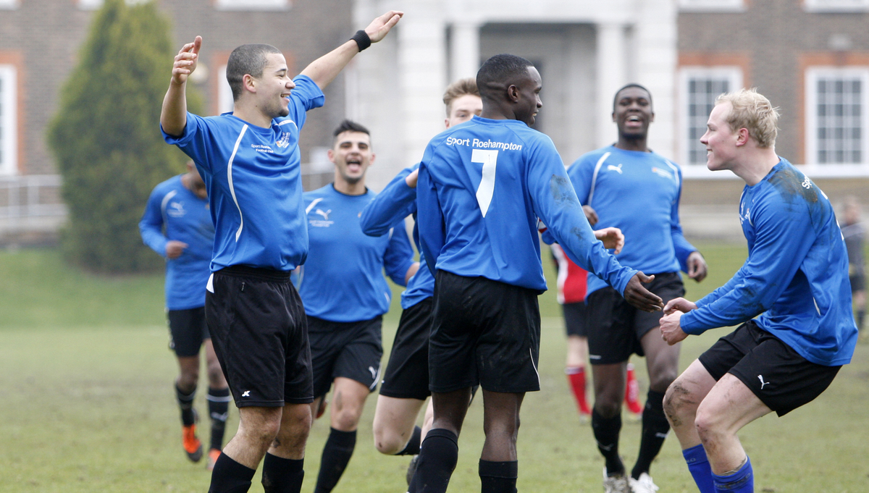
Social Life
Notes:
There are loads of different things you can get involved in while studying at Roehampton. They include:
Societies
Subject societies (Classics, Film, Philosophy) Drama Societies, Dance Societies, Debating Society, Religious Societies and more
Sports
Badminton, Boxing, Cheerleading, Judo, Squash, Swimming, Taekwondo
Restaurants
Union Bar, Wired Café, Selection of Restaurants and Bars
Bars
Union Bar, Selection of Bars across Campus
Student’s Union
Academic Support, Activities, Campaigns, Welfare, Events and Volunteering
Departmental/Cultural Events
Comedy, Karaoke, Club Nights, Fresher's Week, Xmas Bash and Summer Ball
As well as a range of charitable and volunteering opportunities. If we don’t have a society that you’re interested in, but have an idea for one, then all you need are 9 other like-minded people to join you and you can start your own society.
We also have our own sustainable café on campus called The Hive. This is run by the Students’ Union and the actual café is made out of recycled shipping containers. Students volunteer with the café to grow their own vegetables on campus and run thrift shops and market days. We also keep chickens on campus!
The Students Union run a number of events including a weekly club night on campus (Bop!), a weekly club night off campus (Fez) and also a monthly club night of campus (Grand). All the profits from these events go towards putting on the annual Summer Ball. This is a festival-style event at the end of May to celebrate the end of term. They usually get some decent artists to play at the ball – recent ones include Katy B, Tinchy Strider, The Feeling, Scouting for Girls, Professor Green and Rizzle Kicks.

Slide 24
Fresher's Week
Notes:
Fresher’s week will be your very first week on campus, and is packed full of activities to help you settle into university life.
There are the academic sessions the give you information on your course and your module options. You will also enrol during Freshers’ Week, which is when you get your student ID and confirm that you have turned up for your place at university.
You will also meet and get to know your flat rep during Freshers’ Week. Every flat/floor of student accommodation for 1st year undergraduate students will have a flat-rep living with them. The flat rep will be an older student, usually in their 2nd or 3rd year, who will be responsible for helping the new students to settle in, lead in social activities and be there as a calling point if a student is ever in need of help – emotionally or academically. This is especially relevant during Freshers’ Week when the flat rep will show the students the campus, give them information they will need for university life and go with them to all the Freshers events the RSU puts on for the week.
The social side of Freshers’ Week comprises events ranging from meeting your RSU representatives and getting to know what’s available to you on campus to club nights on and off campus. They have even hired out Thorpe Park for an evening so it can be used exclusively by Roehampton students last year (2019). The day events culminate in the Freshers’ Fayre, where you can join the clubs and societies you’re interested in and find information about the university, pick up freebies and find out about the part-time work available to you as a student. The night events are then topped off with the Freshers’ Finale, with Main acts, DJs, Silent Social and a Food Court to round off the week.

Slide 25
College System
Notes:
Some University have a college system at Roehampton we have four different colleges here on campus.
Whitelands (Badgers)
Southlands (Sharks)
Digby (Lions)
Froebel (Zeebras)
These colleges are represented by students throughout the events of the college cup (think Harry Potter – we even have a quidditch match!). There are also other events such as Frigby (Froebel vs Digby football game) and college themed BOP! nights on campus.
This not only promotes friendly competition between the colleges, but it helps you build your identity when at the university. The college you belong to is usually drawn from where you live in your first year, but if you live off campus then it will be on which college you study on. It is impossible to study at the University of Roehampton and not identify yourself with one of the colleges here. If offers a real sense of community that is unique to this university and improves the experience of students here.

Slide 26
Contact Us
@
Schoolsliaison@roehampton.ac.uk
@Uni_Roehampton
@RoeOutreach
@RoehamptonUni
@RoeOutreach
facebook.com/roehamptonuni/
www.roehampton.ac.uk/contactus
Notes:
Head over to our website for live chat or to order a prospectus

